Slide 1


Authentication & Password
SE3331-1 (2022 Fall)
IPADS, Shanghai Jiao Tong University
https://www.sjtu.edu.cn
Notes:
Credits to Mike Freedman (COS 461) and others.

Slide 2
Review
Security is a negative goal
Want to achieve something despite whatever adversary might do
How to make progress in building a secure system?
Be clear about goals: "policy"
C.I.A.
Be clear about assumptions: "threat model"
What are the assumptions?
Notes:
We've seen negative goals already: all-or-nothing atomicity w/ crashes.
With crashes, just had to think of where we might crash.
Much harder to consider all possible cases with an adversary.
Security is also often hard because system has many complex goals.

Slide 3
Threat Model: Assumptions
What does a threat model look like?
Adversary controls some computers, networks (but not all)
Adversary controls some software on computers he doesn't fully control
Adversary knows some information, such as passwords or keys (but not all)
Adversary knows about bugs in your software?
Physical attacks?
Social engineering attacks?
Resources? (Can be hard to estimate either resources or requirements!)

Slide 4
Threat Model: Assumptions
Unrealistic / incomplete threat models
Adversary is outside of the company network / firewall
Adversary doesn't know legitimate users' passwords
Adversary won't figure out how the system works
Despite this, important to have a threat model
Can reason about assumptions, evolve threat model over time
When a problem occurs, can figure out what exactly went wrong and re-design
Overly-ambitious threat models not always a good thing
Not all threats are equally important
Stronger requirements can lead to more complexity
Complex systems can develop subtle security problems

Slide 5

Guard Model

Slide 6
Guard Model of Security
Complete mediation(完全中介)
Only way to access the resource involves the guard
1. Must enforce client-server modularity
Adversary should not be able to access server's resources directly
E.g., assume OS enforces modularity, or run server on separate machine
2. Must ensure server properly invokes the guard in all the right places
但是这个guard的保护作用并不绝对，因为这个guard的保护作用一定要在程序运行之后才能够起作用，而如果attacker直接攻击了硬盘，也是可能发生的。

Slide 7
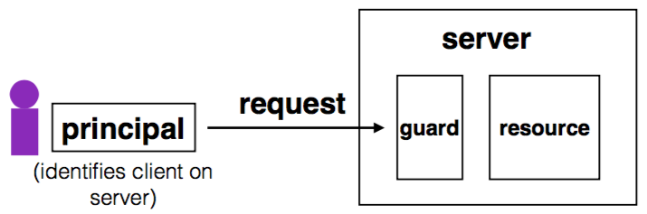
Complete Mediation
Guard typically provides:
Authentication(身份认证): is the principal who they claim to be?
Authorization(权限认证): does principal have access to perform request on resource?

Slide 8
Designing the Guard
Two functions often provided by a guard:
Authentication: request -> principal
E.g., client's username, verified using password
Authorization: (request, principal, resource) -> allow?
E.g., consult access control list (ACL) for resource
Simplifies security
Can consider the guards under threat model
But don't forget about complete mediation

Slide 9
Example: Unix FS
对于每一个文件系统的client，实际上就是一个process，在用户登录之后创建的第一个child process称作shared process，其对应的principal就是用户登录时使用的userID。之后在通过shared process进行fork的时候会共享这个userID，但是有过期时间。
Resource: files, directories.
Server: OS kernel.
Client: process.
Requests: read, write system calls.
Mediation: U/K bit / system call implementation.
Principal: user ID.
Authentication: kernel keeps track of user ID for each process.
Authorization: permission bits & owner uid in each file's inode.

Slide 10
Example: Web Server
Resource: Wiki pages
Client: any computer that speaks HTTP
Server: web application, maybe written in Python
Requests: read/write wiki pages
Mediation: server stores data on local disk, accepts only HTTP reqs
Principal: username
Authentication: password
Authorization: list of usernames that can read/write each wiki page
Notes:
Note: requires setting file permissions, etc; assumes OS kernel provides complete mediation.

Slide 11
Example: Firewall
Resource: internal servers
Client: any computer sending packets
Server: the entire internal network
Requests: packets
Mediation:
internal network must not be connected to internet in other ways(没有firewall内外网无法连接)
no open wifi access points on internal network for adversary to use
no internal computers that might be under control of adversary
Principal, authentication: none
Authorization: check for IP address & port in table of allowed connections

Slide 12
What Can Go Wrong?
1. Bypass(绕过) complete mediation by software bugs
2. Bypass complete mediation by an adversary
3. Policy vs. mechanism
4. Interactions between layers, components
5. Users make mistakes
6. Cost of security

Slide 13
Bypassing Complete Mediation
All ways to access resource must be checked by guard
Common estimate: one bug per 1,000 lines of code
Adversary may trick server code to do something unintended, bypass guard
How to prevent bypassing?
Reduce complexity: reduce lines of code
The "principle of least privilege"

Slide 14
Example: Paymaxx.com (2005)
https://my.paymaxx.com/
Requires username and password
If you authenticate, provides menu of options
One option is to get a PDF of the tax form
https://my.paymaxx.com/get-w2.cgi?id=1234(明文，无法进行有效的身份认证)
Gets a PDF of W2 tax form for ID 1234
get-w2.cgi forgot to check authorization
Attacker manually constructs URLs to fetch all data

Slide 15
Example: SQL Injection
SQL injection攻击：通过人为的注入一些特殊字符修改SQL的原始语义，从而使其进行错误的行为。
username | email | public?
rongc | rongc@sjtu.edu.cn | yes
xiay | xiayb@sjtu.edu.cn | yes
haiboc | haibo@sjtu.edu.cn | no
SELECT username, email FROM users WHERE
username='<username>' AND public='yes'
Let <username> = katrina' OR username='
SELECT username, email FROM users WHERE
username='xiay' OR username='' AND
public='yes'

Slide 16
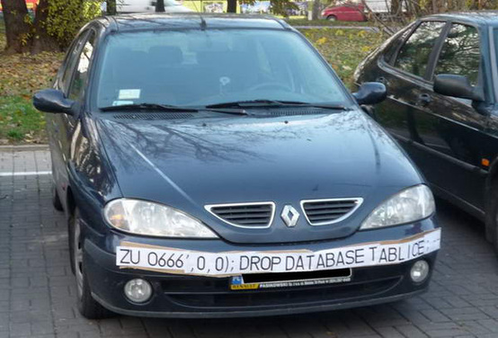
SQL Injection
ZU 0666',0,0);; DROP DATABASE TABLICE;

Slide 17
Authentication: Password

Slide 18
Authentication: Who Are You?
Something you know
E.g., passwords, answers of questions
Something you have
E.g., keys or smart cards
Something you are
E.g., fingerprint, iris, or other biometric method
Q: What are their pros and cons?
know：cons：容易丢失，并且输入相对麻烦
have：cons：容易丢失，容易被偷
are：pros：难以复制，具有很好的唯一性，cons：由于很难修改，一旦泄露无法保护

Slide 19
Authentication: Password
Password goals
Authenticate user
Adversary must guess
For random 8-letter passwords, ~26⁸?
Guessing is expensive

Slide 20
An Example: Guessing Password (Tenex)
checkpw (user, passwd):
acct = accounts[user]
for i in range(0, len(acct.pw)):
if acct.pw[i] ≠ passwd[i]:
return False
return True
问题：容易暴露不匹配的位置，因为在不匹配的时候会直接return false，时间会比全部匹配少。攻击者可以通过计时的方式进行攻击。
一种可能的解决方式是：不要不匹配就return，而是只做一个标记，在全部比较之后在return。
passwd:
P
A
S
S
W
O
R
D
X
acct.pw:
P
A
S
S
w
O
R
D

Slide 21
Problem: Guess One Character at a Time
Guess a password
Allocate password 1 byte away from a page boundary
Page-fault means first char is OK
Example of cross-layer interactions
Problem: server has a copy of all passwords
If adversary exploits buffer overflow, can get a copy of all passwords

Slide 22
Timing Attack: Guess One Character at a Time
Guess a password
Allocate password 1 byte away from a page boundary
Page-fault means first char is OK
Example of cross-layer interactions
Also known as "Timing Attack"

Slide 23

Timing Attack: Guess One Character at a Time
Page in Memory
a
b
c
ca
…
cs
…
Page on Disk -> Page Fault
aaaaaa
aaaaaa
aaaaaa
aaaaa
aaaaa
Time = 1ms
Time = 1ms
Time = 10ms
Time = 1ms
Time = 10ms
根据前面的比较算法，如果不相同会直接return，因而只有相同的情况下才会取访问下一位，即会导致page fault。而这会导致磁盘访问，所以很慢。即通过读磁盘来放大时间差
Page Fault!
The 1st char must be 'c'
Page Fault!
The 2nd char must be 's'

Slide 24
Idea: Store Hash of Password
Hash functions: arbitrary strings to fixed-length output
Common output sizes are 160 bits, 256 bits, ..
One-way: given H(x), hard to recover x
Collision-resistant: hard to find different x and y such that H(x)=H(y)
Evolve(发展) over time: SHA-0 and MD-5 used to be popular, now considered broken

Slide 25
Store Hash of Password
Accounts database stores hash of every user's password
Compute hash, check if the hash matches
Solves not only the password theft problem, but also the page-fault attack
使用HASH：将不等长的密码变成等长的字符串，从而进行”加密”，提高正面攻击的难度。
但是，这种方式并不完全好用。因为对于一些很常用的密码，通过这种方式生成的hash是一样的，所以可以通过预先生成一个table的方式进行反向查找。

Slide 26
Store Hash of Password
username | hash(password) arya | de5aba604c340e1965bb27d7a4c4ba03f4798ac7
jon | 321196d4a6ff137202191489895e58c29475ccab
Sansa | 6ea7c2b3e08a3d19fee5766cf9fc51680b267e9f
hodor | c6447b82fbb4b8e7dbcf2d28a4d7372f5dc32687
check_password(username, inputted_password):
stored_hash = accounts_table[username]
inputted_hash = hash(inputted_password)
return stored_hash == inputted_hash

Slide 27
Store Hash of Password
What happens if an adversary breaks into a popular web site with 1M accounts?
Adversary steals 1M hashes
Problem: adversary can guess each password one-by-one
Problem: worse yet, adversary can build table of hashes for common passwords
Often called a "rainbow table"
Users are not great at choosing passwords, many common choices

Slide 28
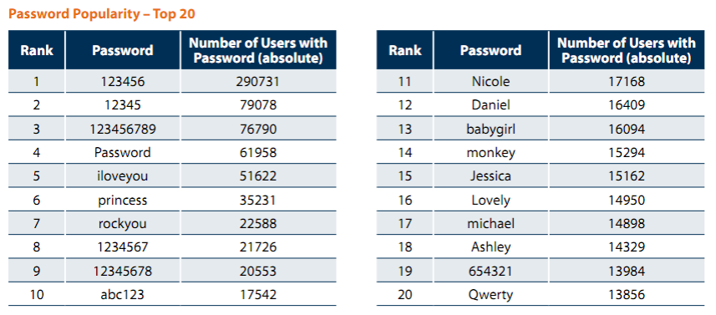
Password Statistics (32M Password, 2009)
5,000 unique password account for 6.4M users (20%)
Similar statistics confirmed again in 2010 (Gawker break-in)
"Consumer Passwords Worst Practices" report by Imperva

Slide 29
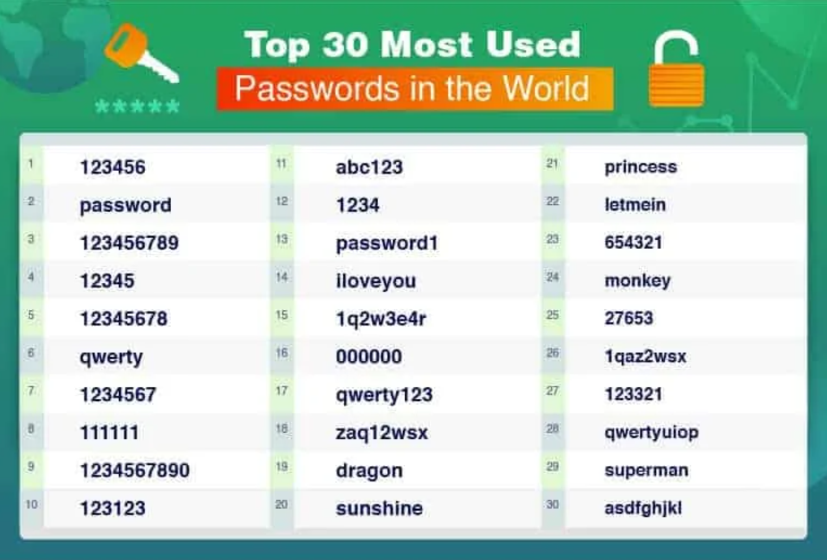
30 Most Used Passwords in 2022

Slide 30
Store Hash of Password
Important to think of human factors when designing security systems
Not much we can do for users that chose "123456"
Plenty of bad passwords have numbers, uppercase, lowercase, etc.
What matters is the (un)popularity of a password, not letters/symbols
But we can still make it a bit harder to guess less-embarrassing passwords

Slide 31
Salting
Salting: make the same password have different hash values
Makes it harder to build a pre-defined lookup table
Choose random salt value when storing the password (& store the salt)
Store hash of salt and password together
Use the original salt to compute a matching hash when verifying password
Every password has many possible hash values -> impractical to build rainbow table
Use a much more expensive hash function
For reference: look up "bcrypt" by Provos and Mazieres
使用salt：解决了相同密码会有相同hash的问题，但是也不完美。因为salt需要明文存储在数据库中，一旦数据库被攻击，也无法起到保护作用。

Slide 32
Salting
username | salt | hash(password | salt)
arya | 5334900209 | c5d2a9ffd6052a27e6183d60321c44c58c3c26cc
jon | 1128628774 | 624f0ffa577011e5704bdf0760435c6ca69336db
Sansa | 8188708254 | 5ee2b8effce270183ef0f4c7d458b1ed95c0cce5
Hodor | 6209415273 | f7e17e61376f16ca23560915b578d923d86e0319
check_password(username, inputted_password)
stored_hash = accounts_table[username]
inputted_hash = hash(inputted_password | salt)
return stored_hash == inputted_hash

Slide 33
Bootstrap Authentication
Do not want to continuously authenticate with password for every command
Typing, storing, transmitting, checking password: risk of compromise
In Unix login:
Login process exchanges password for userid
In web applications:
Often exchange password for a session cookie
Can think of it as a temporary password that's good for limited time

Slide 34
Session Cookies: Strawman
First check username and password, if ok, send:
Use the tuple to authenticate user for a period of time
Nice property: no need to store password in memory, or re-enter it often
Server_key is there to ensure users can't fabricate hash themselves
Arbitrary secret string on server, can be changed (invalidating cookies)
Can verify that the username and expiration time is valid by checking hash
{username, expiration, H(server_key | username | expiration)}

Slide 35
Session Cookies: Strawman
Problem: the same hash can be used for different username/expiration pairs!
E.g., "Ben" and "22-May-2012" may also be "Ben2" and "2-May-2012"
Concatenated string used to compute the hash is same in both cases!
Can impersonate someone with a similar username
Principle: be explicit and unambiguous when it comes to security
E.g., use an invertible delimiter scheme for hashing several parts together(用特殊字符分割不同的字段)

Slide 36
Phishing Attacks(钓鱼攻击)
Adversary tricks user into visiting legitimate-looking web site (e.g., bank)
Asks for username/passwd
Actually a different server operated by adversary
E.g., bank0famerica.com instead of bankofamerica.com
Stores any username/passwd entered by victims
Adversary can now impersonate victims on the real web site

Slide 37
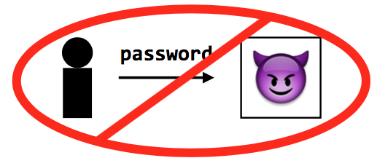
Key Problem of Password
Key problem: once you send a password to the server, it can impersonate(冒充，假冒) you
Solved part of the problem by hashing the password database
But still sending the password to the server to verify on login

Slide 38
Technique 1: challenge-response scheme
Challenge-response
Server chooses a random value R, sends it to client
Client computes H(R + password) and sends to server
Server checks if this matches its computation of hash with expected password
If the server didn't already know password, still doesn't know

Slide 39
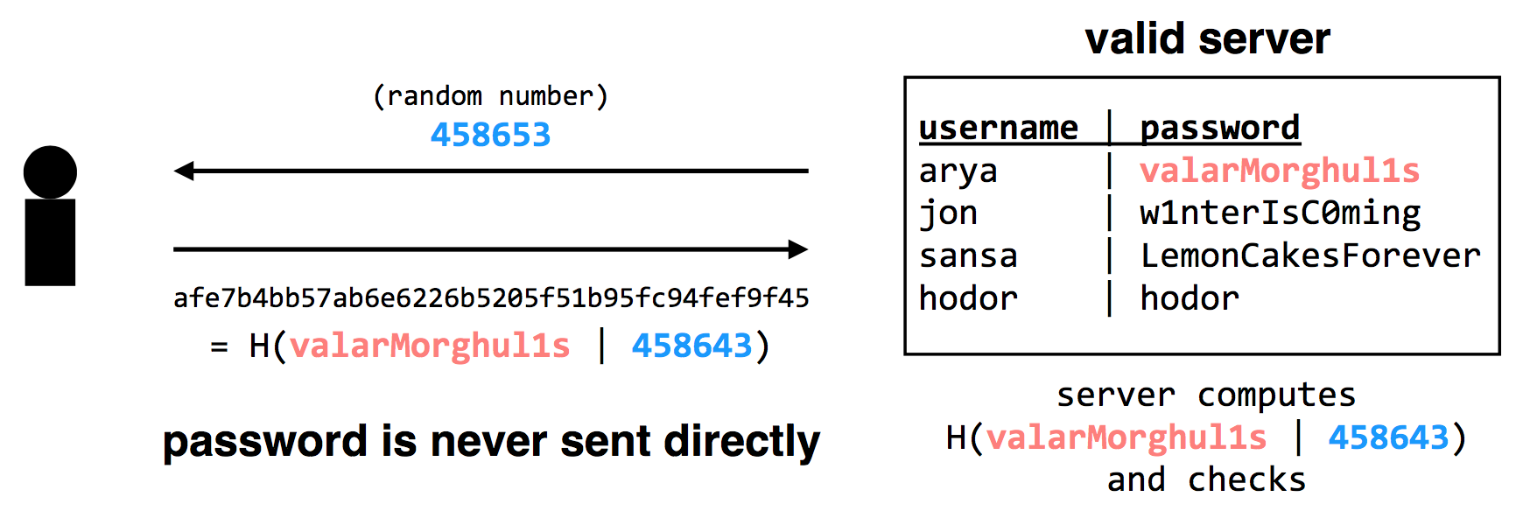
Technique 1: challenge-response scheme
Adversary only learns H(valarMorghul1s | 458643); can not recover the password from that

Slide 40
Tech 2: use passwords to authenticate the server
Make the server prove it knows your password
Client chooses Q, sends to server, server computes H(Q + password), replies
Only the authentic server would know your password!
Unfortunately, not many systems use this in practice
In part because app developers just care about app authenticating user...
Notes:
Slight problem: simple challenge-response can't be used with hashed passwords.
Need the original password to compute hash together with random challenge.
If we store the hashed password, its hash now becomes the effective password..
There's a protocol that allows both.
Store a "hash" of password, challenge-response auth.
Look up "SRP" if building a real system (details too complicated for 6.033).

Slide 41
Tech 2: use passwords to authenticate the server
Complication: could be used with first scheme to fool server!
First, try to log into the server: get the server's challenge R
Then, decide you want to test the server: send it the same R
Send server's reply back to it as response to the original challenge
Principle: be explicit, again!
E.g., hash the intended recipient of response (e.g., client or server), and have the recipient verify it
Notes:
Slight problem: simple challenge-response can't be used with hashed passwords.
Need the original password to compute hash together with random challenge.
If we store the hashed password, its hash now becomes the effective password..
There's a protocol that allows both.
Store a "hash" of password, challenge-response auth.
Look up "SRP" if building a real system (details too complicated for 6.033).

Slide 42
Tech 3: turn offline into online attack
Turn phishing attacks from offline into online attacks
If adversary doesn't have the right image, users will know the site is fake
Adversary could talk to real site, fetch image for each user that logs in

Slide 43
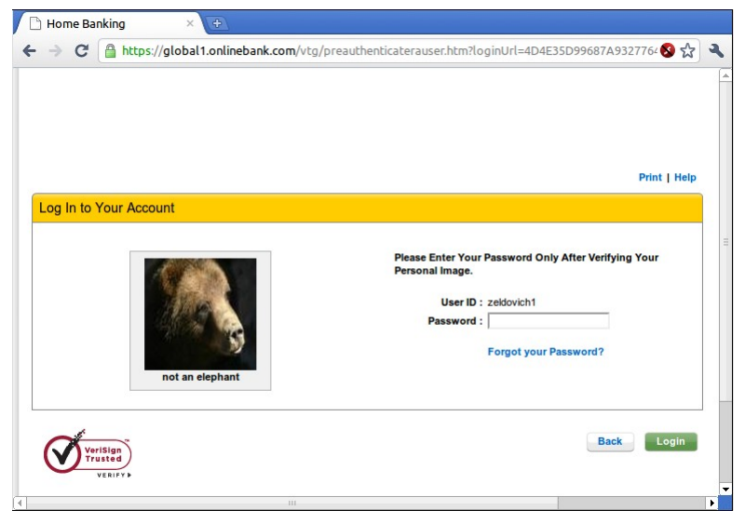
"Sitekey"

Slide 44
Tech 3: turn offline into online attack
Why is it still useful, then?
Requires more efforts on adversary's part to mount attack
Even if adversary does this, bank can detect it(同一个服务器不太可能在同一时间请求多个不同用户的数据)
Watch for many requests coming from a single computer
That computer might be trying to impersonate site
Turns an offline/passive attack into an online/active attack
Key insight
Don't need perfect security, small improvements can help

Slide 45
Tech 4: Specific password
Make passwords specific to a site
Instead of sending password, send H(servername + password)
Just like a basic password scheme, from the server's point of view
Except impersonator on another server gets diff passwd
Recommendation
E.g., LastPass

Slide 46
Tech 5: one-time passwords
One-time Password
If adversary intercepts password, can keep using it over and over
Can implement one-time passwords: need to use a different password every time
Design: construct a long chain of hashes.
Start with password and salt, as before
Repeatedly apply hash, n times, to get n passwords
Server stores x = H(H(H(H(...(H(salt+password)))))) = H^{n}(salt+password)
To authenticate, send token=H^{{n-1}}(salt+password)
Server verifies that x = H(token), then sets x <- token
User carries a printout of a few hashes, or uses smartphone to compute them.

Slide 47
Tech 5: one-time passwords
Alternative design: include time in the hash (Google's 2-step verification)
Server and user's smartphone share some secret string K
To authenticate, smartphone computes H(K || current time)
User sends hash value to server, server can check a few recent time values.

Slide 48
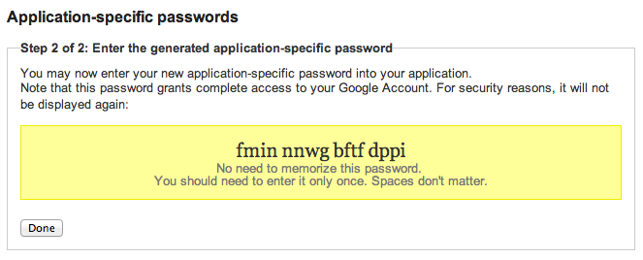
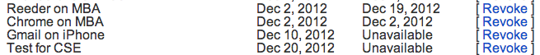
Google's App-specific password

Slide 49
Tech 6: bind authentication and request authorization
One way to look at problem: sending password authorizes any request
Even requests by adversary that intercepts our password
A different design: use password to authenticate any request
req = { username, "write XX to exam.txt", H(password + "write ..") }
Server can check if this is a legitimate req from user using password
Even if adversary intercepts request, cannot steal/misuse password
In practice, don't want to use password, use some session token instead
Could combine well with one-time passwords

Slide 50
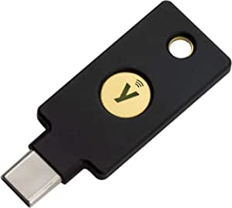
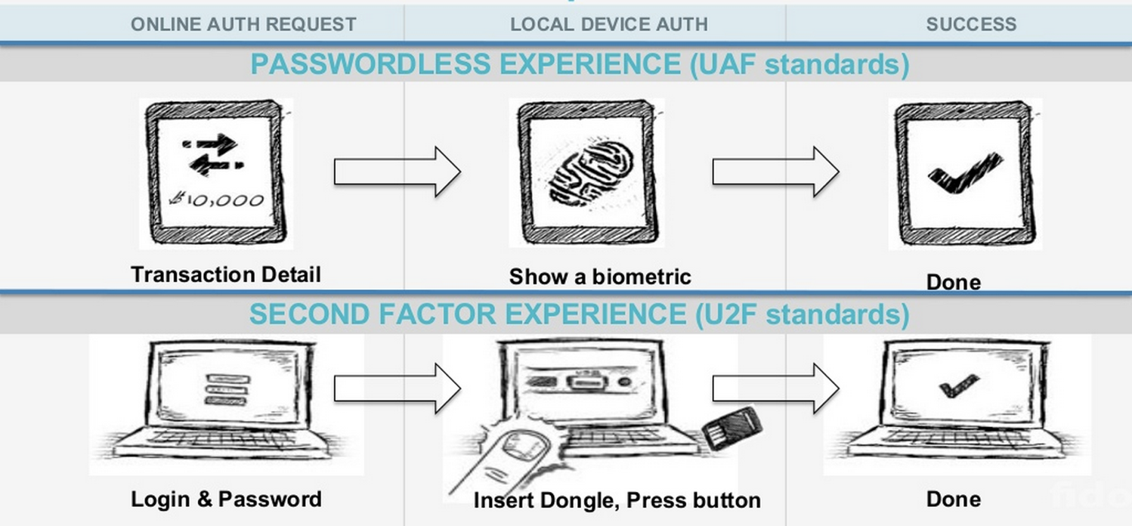
Tech 7: FIDO: Replace the Password

Slide 51
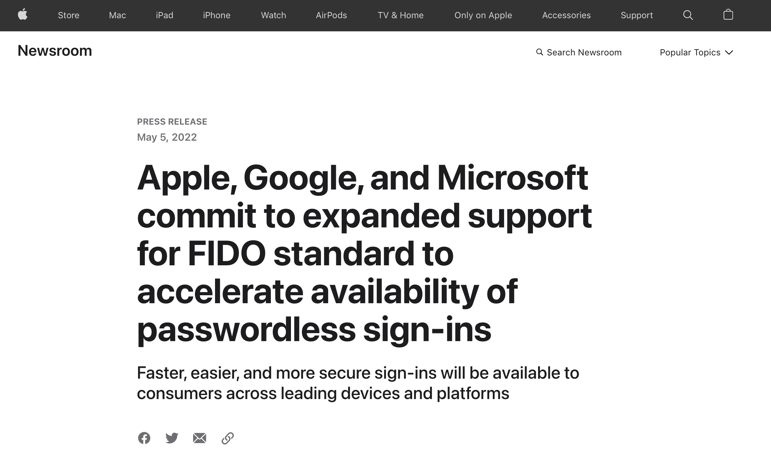

Slide 52
Three Bindings
Fingerprint
User ID
Private key
Publish key
Phone
Server
Secure by hardware (e.g., Enclave)
Secure by isolation

Slide 53
Bootstrapping
How to initially set a password for an account?
If adversary can subvert this process, cannot rely on much else
MIT: admissions office vets each student, hands out account codes
Many web sites: anyone with an email can create a new account
Changing password (e.g., after compromise)
Need some additional mechanism to differentiate user vs. attacker
MIT: walk over to accounts office, show ID, admin can reset password
Many sites: additional "security" questions used to reset password
Password bootstrap / reset mechanisms are part of the security system
Can sometimes be weaker than the password mechanisms
Sarah Palin's Yahoo account was compromised by guessing security Q's
Personal information can be easy to find online

Slide 54
Security Principles

Slide 55
Principle of Least Privilege
Deal with bugs / incomplete mediation
Any component that can arbitrarily access a resource must invoke the guard
If component has a bug or design mistake, can lead to incomplete mediation
General plan: reduce the number of components that must invoke the guard
E.g., arrange for DB server to check permissions on records returned, then security does not depend as much on lookup.cgi

Slide 56
Least Trust
Privileged components are "trusted"
Trusted is bad: you are in trouble if a trusted component breaks
Untrusted components are good: does not matter if they break
Good design has few trusted components, other things do not affect security

Slide 57
Users Make Mistakes
Social engineering, phishing attacks
How many of you really read the permission acquired by apps during installing?
Good idea: threat model should not assume users are perfect

Slide 58
Cost of Security
Security VS. Availability
E.g., system requires frequent password changes -> users may write them down
How far should a teacher go to protect the exam file?
Put the file on a separate computer, to avoid sharing a file system?
Disconnect computer from the network, to avoid remotely exploitable OS bugs?
Put the server into a separate machine room?
Get a guard to physically protect the machine room?
...
Good idea: cost of security mechanism should be commensurate with value
Notes:
Most security goals/policies not infinitely valuable, can tolerate attacks.
Security mechanisms can be expensive (e.g., wasted user time).

